Slide 1
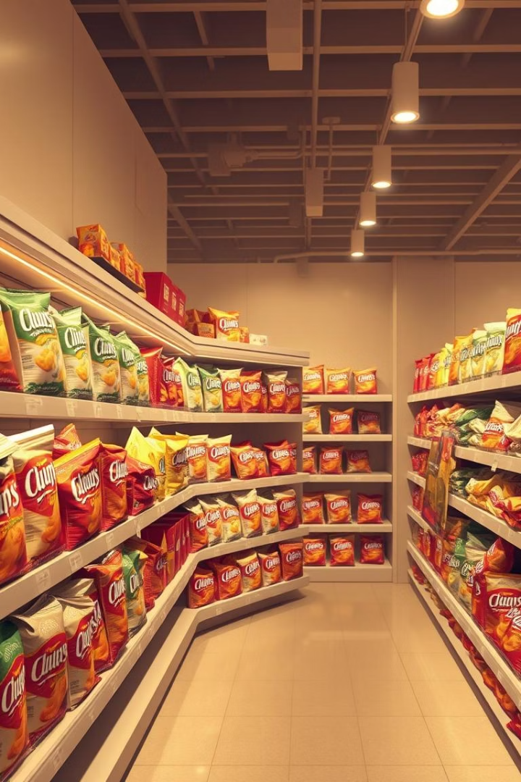
Customer & Transaction Analysis – Retail Chips Insights
Presented by Sahil Lodhi

Slide 2




Project Overview: Uncovering Chips Sales Dynamics
Customer Demographics
Product Preferences
Who buys the most chips?
What specific chips do they purchase?
Spending Habits
Behavioral Patterns
How much are customers spending?
Are purchasing behaviors consistent or random?

Slide 3

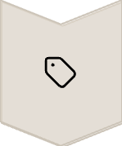


Key Objectives: Driving Sales Growth
Segment Identification
Identify top customer segments for chips.
Pricing Sensitivity
Understand customer price responses.
Preference Revelation
Reveal brand and pack size preferences.
Strategic Recommendations
Propose sales improvement strategies.

Slide 4
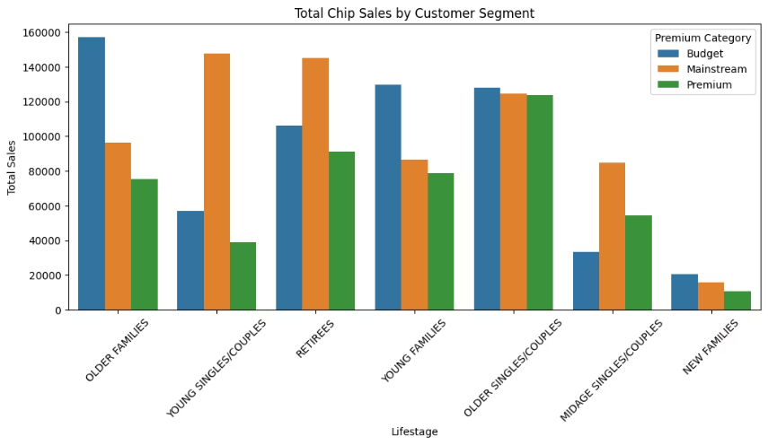
Who's Buying the Most? Segment Analysis
Older Families Lead in Volume
Top total sales, but not always most profitable.
Mainstream Young Singles/Couples
Stand out in targeted value.
Buy a lot and pay more per unit.
Key Takeaway
Prioritize segment quality and profitability.

Slide 5
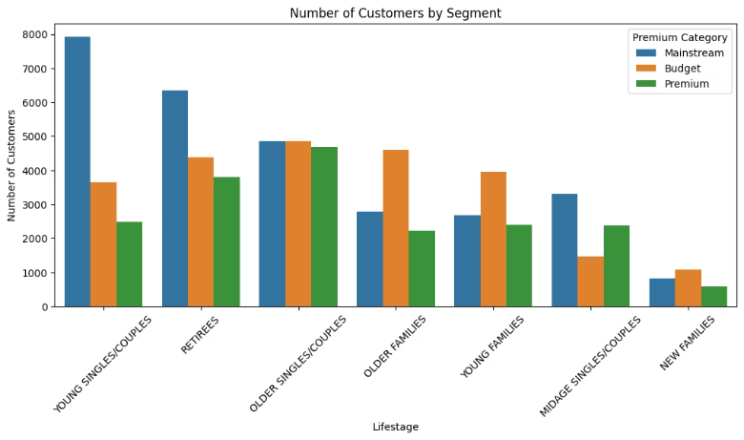
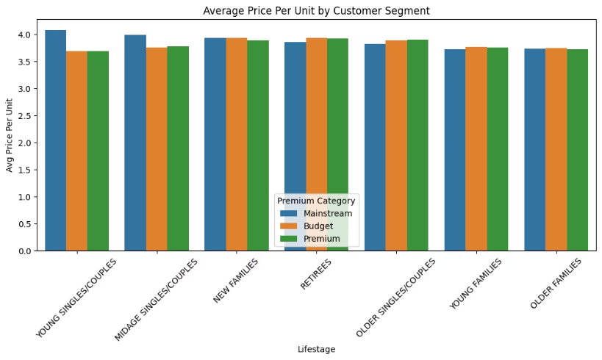
Mainstream Young Singles/Couples: A Profitable Segment
Not the Largest Group
Highest Price Per Unit
Consistent Buying
Strong Preferences
High value, even if not highest volume.
Pay more for each unit purchased.
Show stable purchasing patterns.
Clear brand and pack size loyalty.
This segment is strategically important and highly profitable, deserving precise targeting.

Slide 6
Pricing Validation: Significance of Price Difference
37.83
1.1e-30 < 0.05
T-Stat
P-Value
T-test confirms Mainstream Young Singles/Couples pay significantly more.
Difference is statistically significant, not due to chance.
Focused targeting can boost revenue efficiently and predictably.

Slide 7
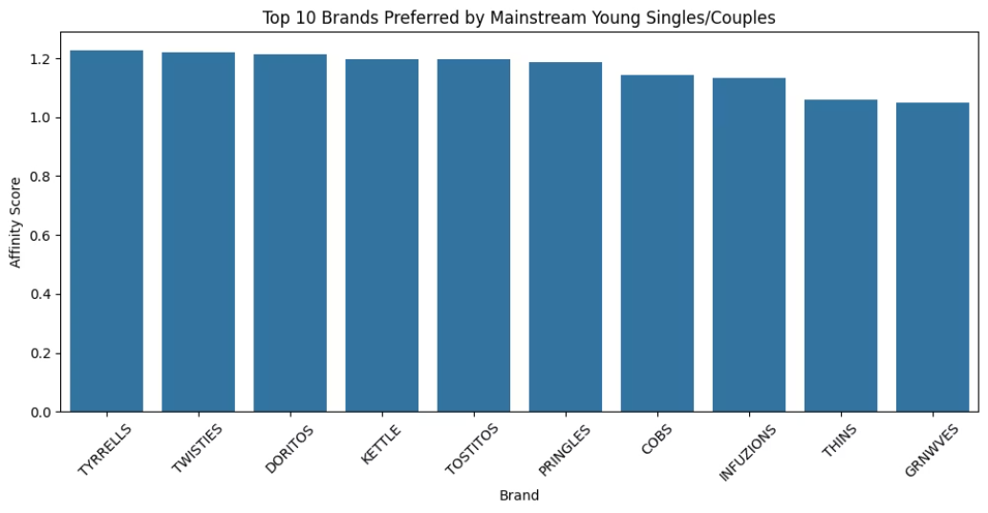



Brand Loyalty: Top Brand Affinity Scores
Strong Brand Preference
This group highly prefers specific brands.
High Loyalty
These are high-loyalty buyers.
Leverage Partnerships
Consider brand collaborations or exclusives.

Slide 8
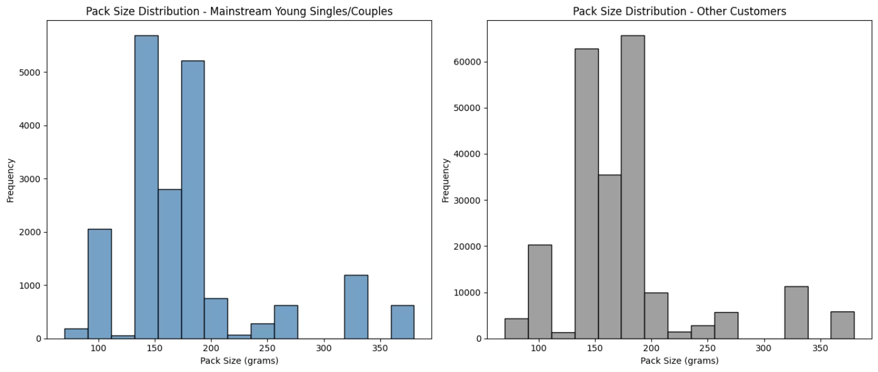



Pack Size Preferences: The Sweet Spot
Optimal Size
Stock Smart
Merchandising
150g–175g packs are preferred.
Ensure preferred sizes are always available.
Optimize shelf placement for these sizes.

Slide 9




Business Recommendations: Driving Growth
Target Key Segment
1
Focus on Mainstream Young Singles/Couples.
Optimize Inventory
2
Stock preferred brands and 150–175g packs.
Launch New Products
3
Develop exclusive or value-tier items.
4
Guide Phase 2
Use insights for future experimentation.

Slide 10



Next Steps: Controlled Testing for Uplift
Controlled Testing
Implement trial vs. control stores.
Measure Uplift
Evaluate changes in packaging, promotions, and placement.
Sales Growth ?
Impact of strategic changes.

